Slide 1
Multi-view 3D Models from Single Images with a Convolutional Network
Jin-Hyuck Cha

Slide 2
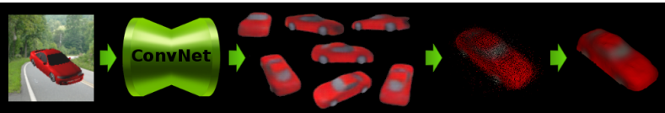
1-1. Introduce
Dataset : ShapeNet
Main idea
Convolution Network guess other invisible aspects.
After that, results are fused to point cloud and get mesh

Slide 3
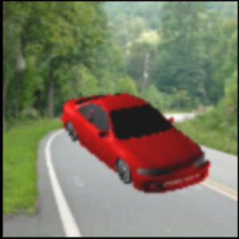
1-2. Special note
Past objects into random backgrounds to make them realistic.
So, the network learns to automatically segment out the object
The first paper which can apply the network to images with non-homogeneous background and natural images

Slide 4
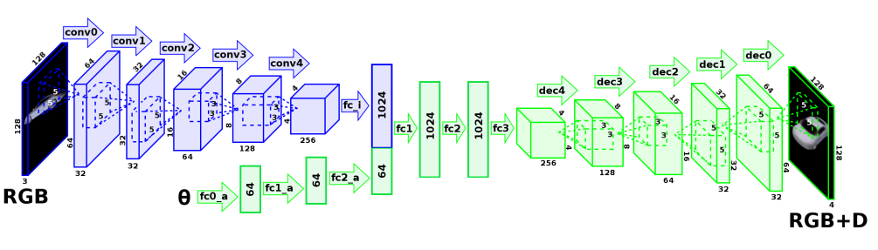
2-1. Architecture
The architecture of our network. The encoder (blue) turns an input image into an abstract 3D representation. The decoder (green) processes the angle, modifies the encoded hidden representation accordingly, and renders the final image together with the depth map

Slide 5

2-2. Loss
y and d are the outputs of the network and λ is the weighting coefficient.
We used λ = 0.1 in our experiments.

Slide 6
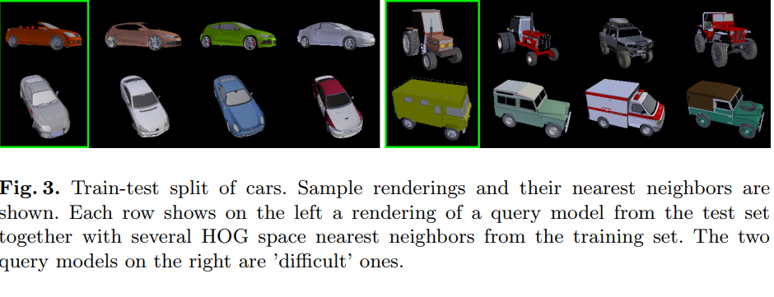
2-3. Multi-view 3D to point cloud and mesh

Slide 7
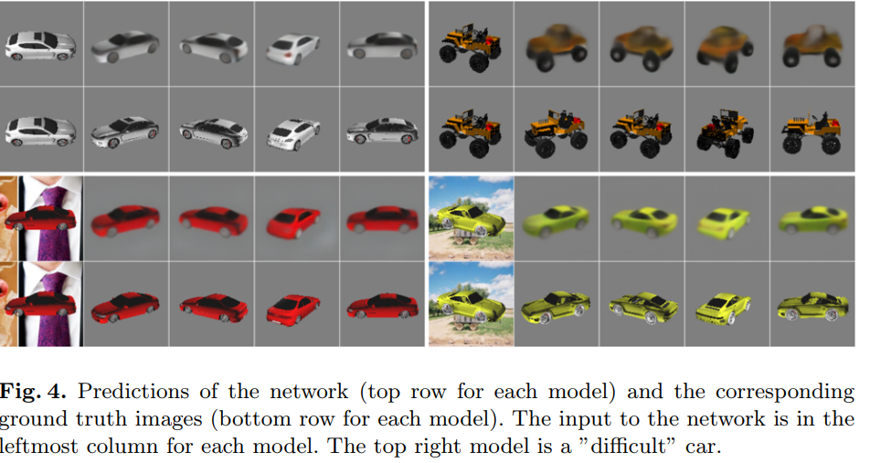
3. results

Slide 8
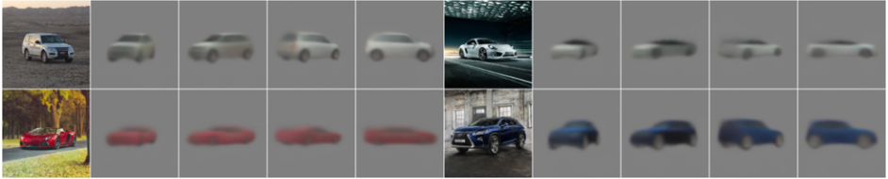
3. results
Prediction about real car

Slide 9
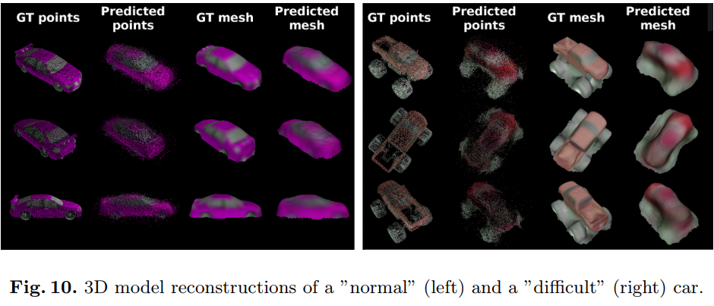
3. results
If the input viewpoint reveals much about the shape of the car, such as the side-view input, the generated images match the ground truth quite well

